Slide 1

HOST BEHAVIOR ANALYSIS FOR PROPERTY RENTAL COMPANY
Dipanjan maity
Nikit oommen

Slide 2
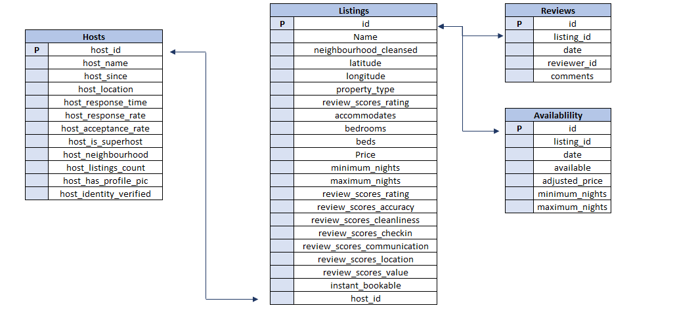
DATA OVERVIEW

Slide 3
Analysis on Acceptance Rate Between Super Host and Normal Host On Different Cities
Over All average Acceptance Rate,
Toronto= 78.8
Vancouver= 85.37
For Toronto city, 66% Super Host have Acceptance Rate more than the average where only 28 % Normal Host have Acceptance Rate more than the average.
For Vancouver City,74% Super Host have Acceptance Rate more than the average where only 45 % Normal Host have Acceptance Rate more than the average.

Slide 4
Analysis on Response Rate Between Super Host and Normal Host On Different Cities
Over All average Response Rate,
Toronto =89.63
Vancouver= 94.64
For Toronto city, 75% Super Host have Response Rate more than the average where only 32 % Normal Host have Response Rate more than the average.
For Vancouver City,79% Super Host have Response Rate more than the average where only 49% Normal Host have Response Rate more than the average.

Slide 5
Analysis on Identity Verification Between Super Host and Normal Host On Different Cities
In Toronto City, We can see that only 6% Super Host are without Identity Verification but in case of Normal Host ,almost 25% Normal Host are without Identity Verification.
In Vancouver City, We can see that only 4% Super Host are without Identity Verification but in case of Normal Host ,almost 17% Normal Host are without Identity Verification.

Slide 6
Analysis on Profile Picture Between Super Host and Normal Host On Different Cities
We have found that Almost all the hosts have a Profile Picture so we can not draw any conclusion on Profile Picture based on our analysis.

Slide 7
Analysis on Review Scores Rating Between Super Host and Normal Host On Different Cities
In Toronto City we can see that almost 98% Super Host have more than 4 Average Review Scores Rating where only 66% Normal Host have more than 4 Average Review Scores Rating
In Vancouver City we can see that almost 98% Super Host have more than 4 Average Review Scores Rating where 77% Normal Host have more than 4 Average Review Scores Rating

Slide 8
Analysis on Positive and Negative Comments Between Super Host and Normal Host On Different Cities
In Toronto City, 87% Super Hosts got atleast 4 positive comments where only 38 % Normal Host got atleast 4 positive comments
In Vancouver City, 91% Super Hosts got atleast 4 positive comments where only 50 % Normal Host got atleast 4 positive comments

Slide 9
Analysis on Big Property Listing Between Super Host and Normal Host On Different Cities
In Toronto City 81% Super Host have atleast one Big Property listing where 73 % Normal Host have atleast one Big Listing
In Vancouver City, 90% Super Host have atleast one Big Property listing where 85% Normal Host have atleast one Big Listing

Slide 10
Analysis on Average Price and Average Available Dates for Year 2023 Between Super Host and Normal Host On Different Cities
For Toronto City,
Average Listing Price For Super Host =$ 251.46
Average Listing Price For Normal Host =$ 244.16
Average Available Dates for Super Host = 114
Average Available Dates for Normal Host = 111
For Vancouver City,
Average Listing Price For Super Host =$ 248.17
Average Listing Price For Normal Host =$ 310.43
Average Available Dates for Super Host = 97
Average Available Dates for Normal Host = 98

Slide 11
Analysis on Local Host and Outsider Host On Different Cities
In our analysis we have found that for Toronto city,
Total Number of Host who lives near to their Listing Property = 1490
Total Number of Host who are Outsider to their Listing Property = 4906
In our analysis we have found that for Vancouver city,
Total Number of Host who lives near to their Listing Property = 1318
Total Number of Host who are Outsider to their Listing Property = 1551

Slide 12
Analysis on Acceptance Rate Between Local Host and Not Local Host in Different Cities
In Toronto City,
29% Local Host out of all Local Host have Acceptance rate more than 80
30% Not Local Host of all Not Local Host have Acceptance rate more than 80
In Vancouver City,
56% Local Host out of all Local Host have Acceptance rate more than 80
65% Not Local Host out of all Not Local Host have Acceptance rate more than 80

Slide 13
Analysis on Response Rate Between Local Host and Outsider Host On Different Cities
In Toronto City,
40% Local Host out of all Local Host have Response rate more than 80
37% Not Local Host of all Not Local Host have Response rate more than 80
In Vancouver City,
62% Local Host out of all Local Host have Response rate more than 80
70% Not Local Host out of all Not Local Host have Response rate more than 80

Slide 14
Analysis on Identity Verified Between Local Host and Outsider Host On Different Cities
In Toronto City,
37% Local Host have their Identity Verified
34% of Outsiders have their Identity Verified
In Vancouver City,
89% Local Host have their Identity Verified
89% Outsiders have their Identity Verified

Slide 15
Conclusion
In our analysis we found out that Vancouver City’s Hosts have more Acceptance Rate in both Super Host and Normal Host
Vancouver City’s Hosts have more Response Rate in both Super Host and Normal Host
Vancouver City’s Hosts have more Identity Verified in both Super Host and Normal Host
Vancouver City’s Hosts have more positive comments than Toronto
Toronto City’s Hosts have more Average Available Dates.
In both the city’s, Outsider Host have more Acceptance Rate than Local Host
In both the city’s, Local Host have more Response Rate than Outsider Host

Slide 16
THANK YOU

